Slide 1
Inventory System-
Inventory Droid
Presented By - Sundar Sujan K

Slide 2
Introduction
Inventories constitute a major component in current assets. It constitutes around 60% in the public limited assets. It constitutes around 60% in the public limited companies, in India. For the smooth running, every enterprises needs inventory. Inventory serve as a link between production processes.

Slide 3
Inventory Management
Inventory is any stored resource that is used to satisfy a current or future need.
Raw materials, work-in-process, and finished goods are examples of inventory.
Two basic questions in inventory management are (1) how much to order management and (2) when to order (or produce), and Product cost.

Slide 4
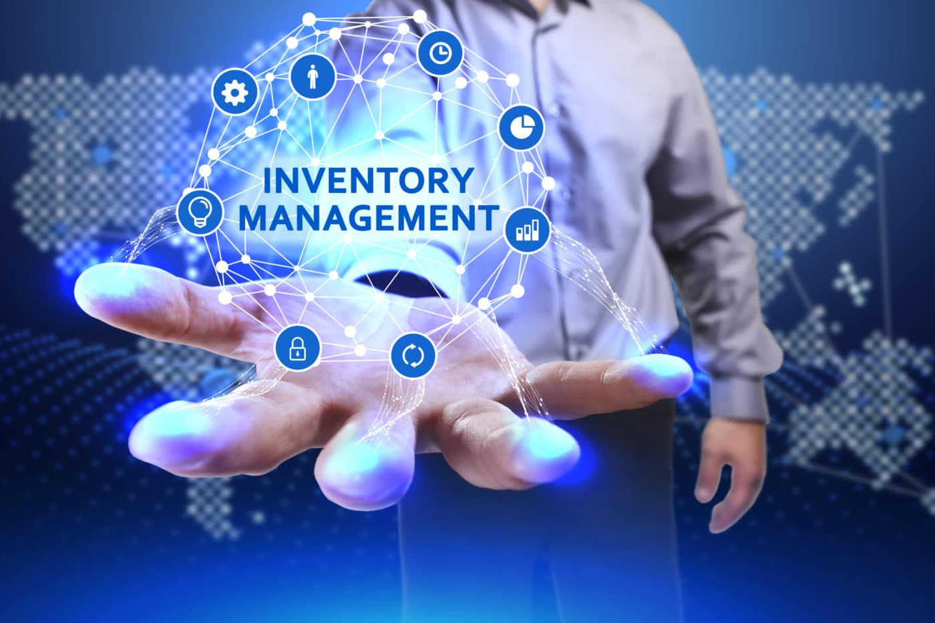
Inventory Management
* Inventories are one of the expensive of
the expensive assets of many companies.
* It represents as much as 40% of
total invested capital.

Slide 5
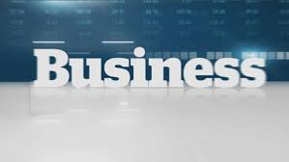
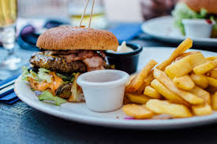
Some Images

Slide 6
Inventory Droid
This is an Inventory management application that allows to maintain and store inventory products that are about to be sold with their records and value.
Inventories stored in the application has 2 types: Business-related and food-related.

Slide 7
Inventory Droid - Accounts
Users can view the homepage and login to their own accounts.
Users can register accounts and create them if they want to use the application.
UserName and password gets stored in the Database. All the registered accounts are available to login and can have their own products and validate them.

Slide 8
Inventory Droid - Validation
Carrying cost - Carrying costs include all the costs of carrying products. They are expressed in rupees.
Based on costs and type , users can validate their product value. For example, If the product is of Business type i.e. Wood, Validation will show high if the costs exceeds 2000 rs.
If the product is of Food type i.e. Cake, Validation will show high if the cost exceeds 300 rs or low if it is below 100 rs.

Slide 9
Inventory Droid - Wallet
This Simple Wallet can be used in the application and helps users to add their budget money and purchase items in the system based on the value and create a bill of materials.
This feature has a maximum and minimum limit on money added by users. This can be a requirement to use this wallet.
This digital wallet will be helpful to users when purchasing items online with a computer or using a smartphone to purchase at a store.

Slide 10
Conclusion
The primary objective of Inventory Droid is to Maintain the quantity of stocks in right manner, at right time and minimize the investment in stock holding. Every firm is faced with two Issues:
Maximize investment by maintaining excessive quantity so that production is not affected and opportunities are not lost.
Minimize investment in inventories as they involve costs and affect probability.

